Slide 1

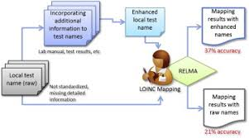
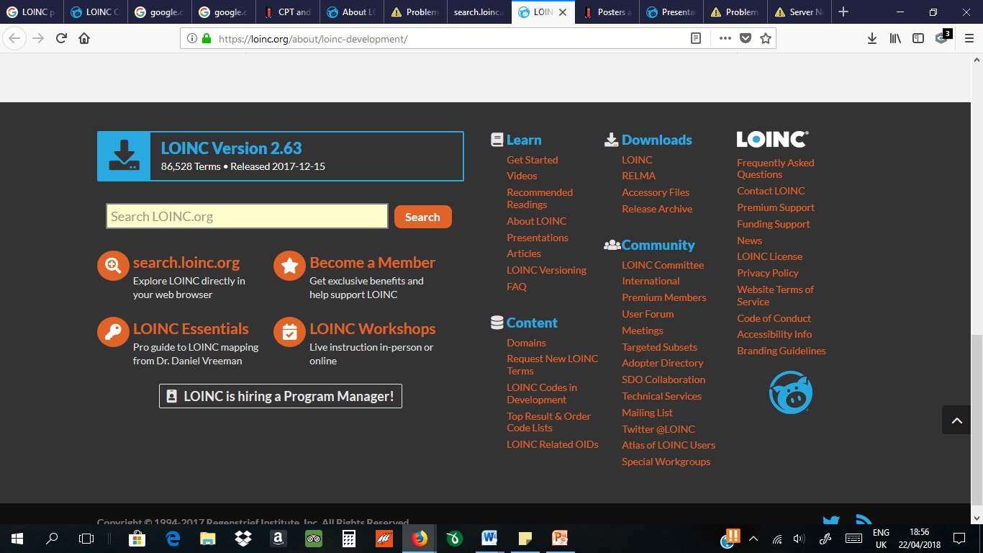
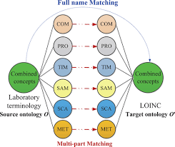
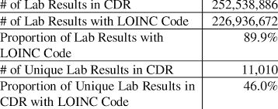
The Logical Observation Identifier Names and Codes (LOINC)
Name
INTRODUCTION
Methods
CONCLUSION
The Logical Observation Identifier Names and Codes (LOINC) database provides a universal code system for reporting laboratory and other clinical observations.
LOINC codes are used by large reference laboratories and federal agencies (e.g., the CDC and the Department of Veterans Affairs) and are part of the Health Insurance Portability and Accountability Act (HIPAA) attachment proposal.
LOINC Committee developed a common terminology for laboratory and clinical observations since there was a growing trend to send clinical data electronically from laboratories and other data producers to hospitals, physician's offices, and payers who use the data for clinical care and management purposes.
Various organizations, institutions, and professionals across the globe, mostly in Europe and Americas use LOINC as part of their work. However, most of these institutions are found in the United States of America.
These institutions provide services including specialist advisory services, research, and training in health sectors focusing in laboratory services and lab technology.
LOINC makes it possible for the exchange and aggregation of clinical results for outcomes management, care delivery, and research as it provides a set of universal codes and structured names that unambiguously identify measured or observed things.
This is made possible because it provide names and universal codes with global language for identifying observations and tests (LOINC, 2018b).
LOINC enables practitioners send clinical data electronically from laboratories and other data producers to hospitals, physician's offices, and payers that use the data for clinical care and management purposes (LOINC, 2018b).
Overview
LOINC is a common language consisting of names, a set of unique identifiers, and codes used in identifying health observations, measurements, and documents.
LOINC provides an elaborate catalog of measurements, together with laboratory tests, clinical measures such as anthropometric measures, vital signs and standardized survey instruments, etc. LOINC also has codes for collections of these items, like forms, panels, and documents (LOINC, 2018a).
LOINC enables the exchange and aggregation of clinical results for care delivery, outcomes management, and research by providing a set of universal codes and structured names to unambiguously identify things you can measure or observe (LOINC, 2018a).
Background
Results
References
LOINC, which stands for Logical Observation Identifiers Names and Codes, was initiated in 1994 by Clem McDonald
At the time—and still today—most laboratories and clinical services use HL7 to send their results electronically from their reporting systems to their care systems.
However, the tests in these messages are identified by means of their internal, idiosyncratic code values.
As a result, receiving care system cannot fully "understand" and properly file the results they receive unless they either adopt the producer's test codes, or invest in the work to map each result producer's code system to their internal code system.
LOINC contains concepts for everything from a serum alpha 1 antitrypsin level to a zygomatic arch x-ray report.
For each concept, LOINC has many other rich details, like synonyms, units of measure, and carefully crafted descriptions.
LOINC. (2018a). LOINC Adopters. LOINC. Retrieved from: http://loinc.org/adopters.
LOINC. (2018). About LOINC. Retrieved from: https://loinc.org/about/

